Slide 1
Deep Learning
CS771: Introduction to Machine Learning
Purushottam Kar

Slide 2
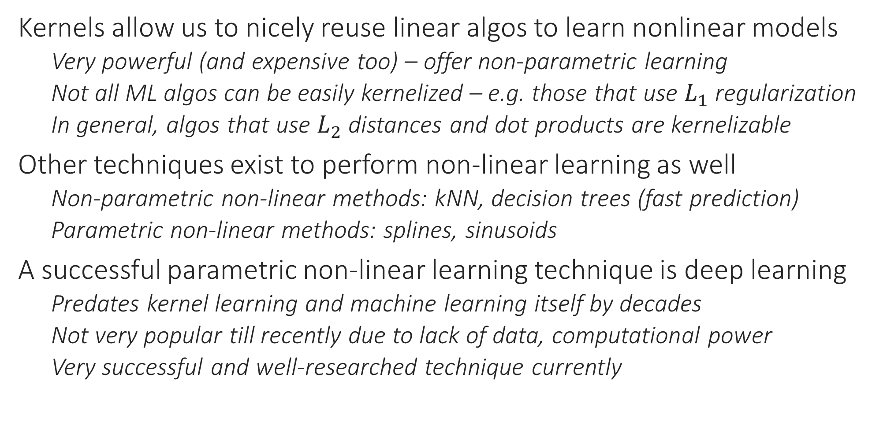
A New Perspective on Non-linear Learning
Kernels allow us to nicely reuse linear algos to learn nonlinear models
Very powerful (and expensive too) – offer non-parametric learning
Not all ML algos can be easily kernelized – e.g. those that use $L_{1}$ regularization
In general, algos that use $L_{2}$ distances and dot products are kernelizable
Other techniques exist to perform non-linear learning as well
Non-parametric non-linear methods: kNN, decision trees (fast prediction)
Parametric non-linear methods: splines, sinusoids
A successful parametric non-linear learning technique is deep learning
Predates kernel learning and machine learning itself by decades
Not very popular till recently due to lack of data, computational power
Very successful and well-researched technique currently

Slide 3
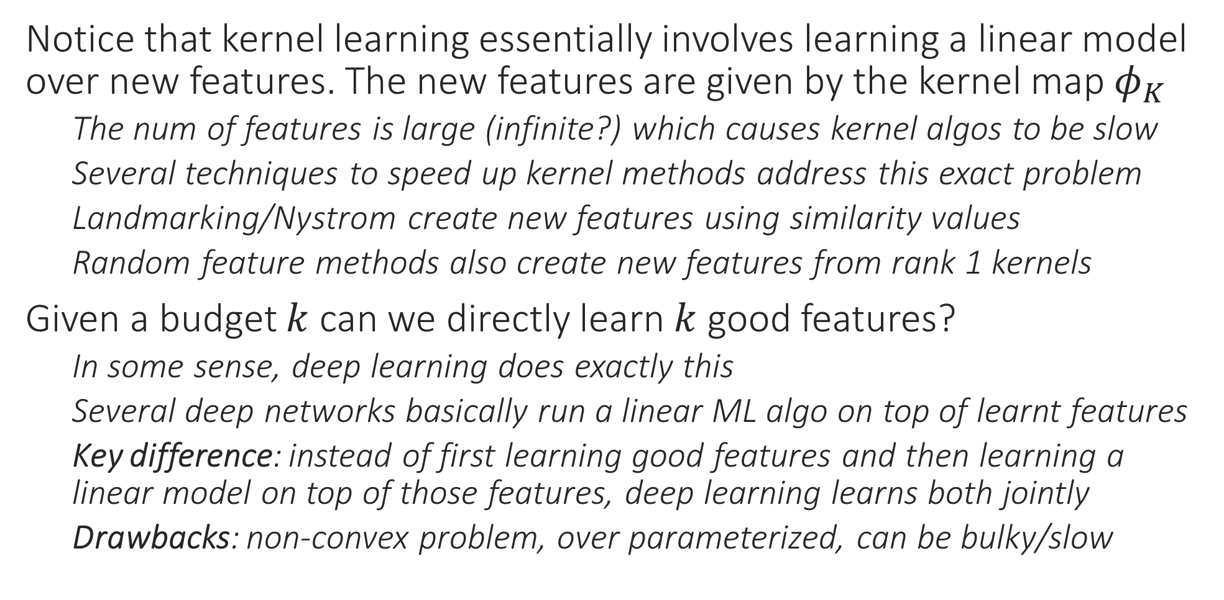
From Kernel Learning to Deep Learning
Notice that kernel learning essentially involves learning a linear model over new features. The new features are given by the kernel map $φ_{K}$
The num of features is large (infinite?) which causes kernel algos to be slow
Several techniques to speed up kernel methods address this exact problem
Landmarking/Nystrom create new features using similarity values
Random feature methods also create new features from rank 1 kernels
Given a budget $k$ can we directly learn $k$ good features?
In some sense, deep learning does exactly this
Several deep networks basically run a linear ML algo on top of learnt features
Key difference: instead of first learning good features and then learning a linear model on top of those features, deep learning learns both jointly
Drawbacks: non-convex problem, over parameterized, can be bulky/slow

Slide 4
Deep Learning Basics
Basic terminology (input, output, hidden nodes and layers)
Activation and loss functions
Universality of deep networks

Slide 5

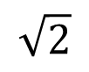
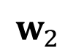

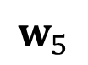

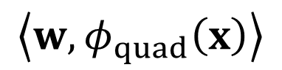
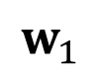
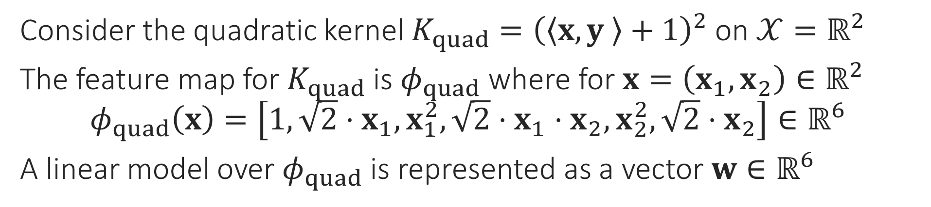
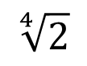
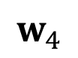



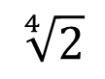

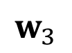
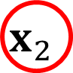

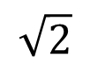
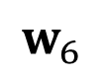
Kernel Learning viewed as Deep Learning
Consider the quadratic kernel $K_{quad}={\left(\left\langle x,y \right\rangle +1\right)}^{2}$ on $𝒳=ℝ^{2}$
The feature map for $K_{quad}$ is $φ_{quad}$ where for $x=\left(x_{1},x_{2}\right)∈ℝ^{2}$ $φ_{quad}\left(x\right)=\left[1, {\sqrt{2}⋅x}_{1}, x_{1}^{2},\sqrt{2}⋅x_{1}⋅x_{2}, x_{2}^{2},\sqrt{2}⋅x_{2}\right]∈ℝ^{6}$
A linear model over $φ_{quad}$ is represented as a vector $w∈ℝ^{6}$
A 3 layer network
Training kernel SVM/kernel RR tunes these weights
$$\left\langle w,φ_{quad}\left(x\right)\right\rangle$$
Input/ouput (or “I/O”) layers are called “visible”
$$+$$
Output layer
$$w_{1}$$
$$w_{6}$$
$$w_{2}$$
$$w_{3}$$
$$w_{4}$$
$$w_{5}$$
$$1$$
$$id$$
$$sq$$
$$×$$
$$sq$$
$$id$$
“Hidden” layer Usually many of these
$$\sqrt{2}$$
$$\sqrt[4]{2}$$
$$\sqrt[4]{2}$$
$$\sqrt{2}$$
$$x_{1}$$
$$x_{2}$$
Input layer

Slide 6
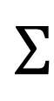
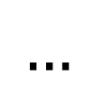
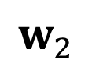
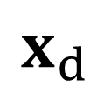
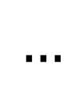
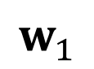
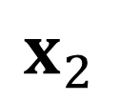
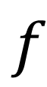
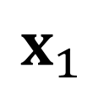
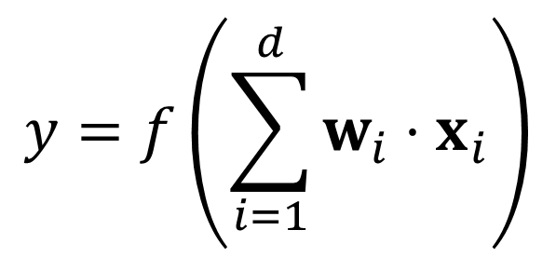
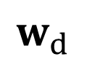
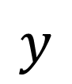
The “Neuron” in Deep/Neural Networks
Output
Output layer: final o/p Input/hidden layer: o/p to other neurons
A network with no hidden layer is just a generalized linear model, also called a perceptron
Activation
Input layer: always id
Output layer: id/softmax/sign etc
Hidden layer: non-linear e.g. ReLU
$$y$$
$$y=f\left(\sum_{i=1}^{d}{w_{i}⋅x_{i}}\right)$$
$$f$$
Input
Input layer: no i/p
Hidden/output layer: i/p taken from other neurons
$$Σ$$
$$w_{1}$$
$$w_{d}$$
$$…$$
Some input items can be bias terms (constant) e.g. 1
$$w_{2}$$
$$x_{1}$$
$$x_{2}$$
$$…$$
$$x_{d}$$

Slide 7
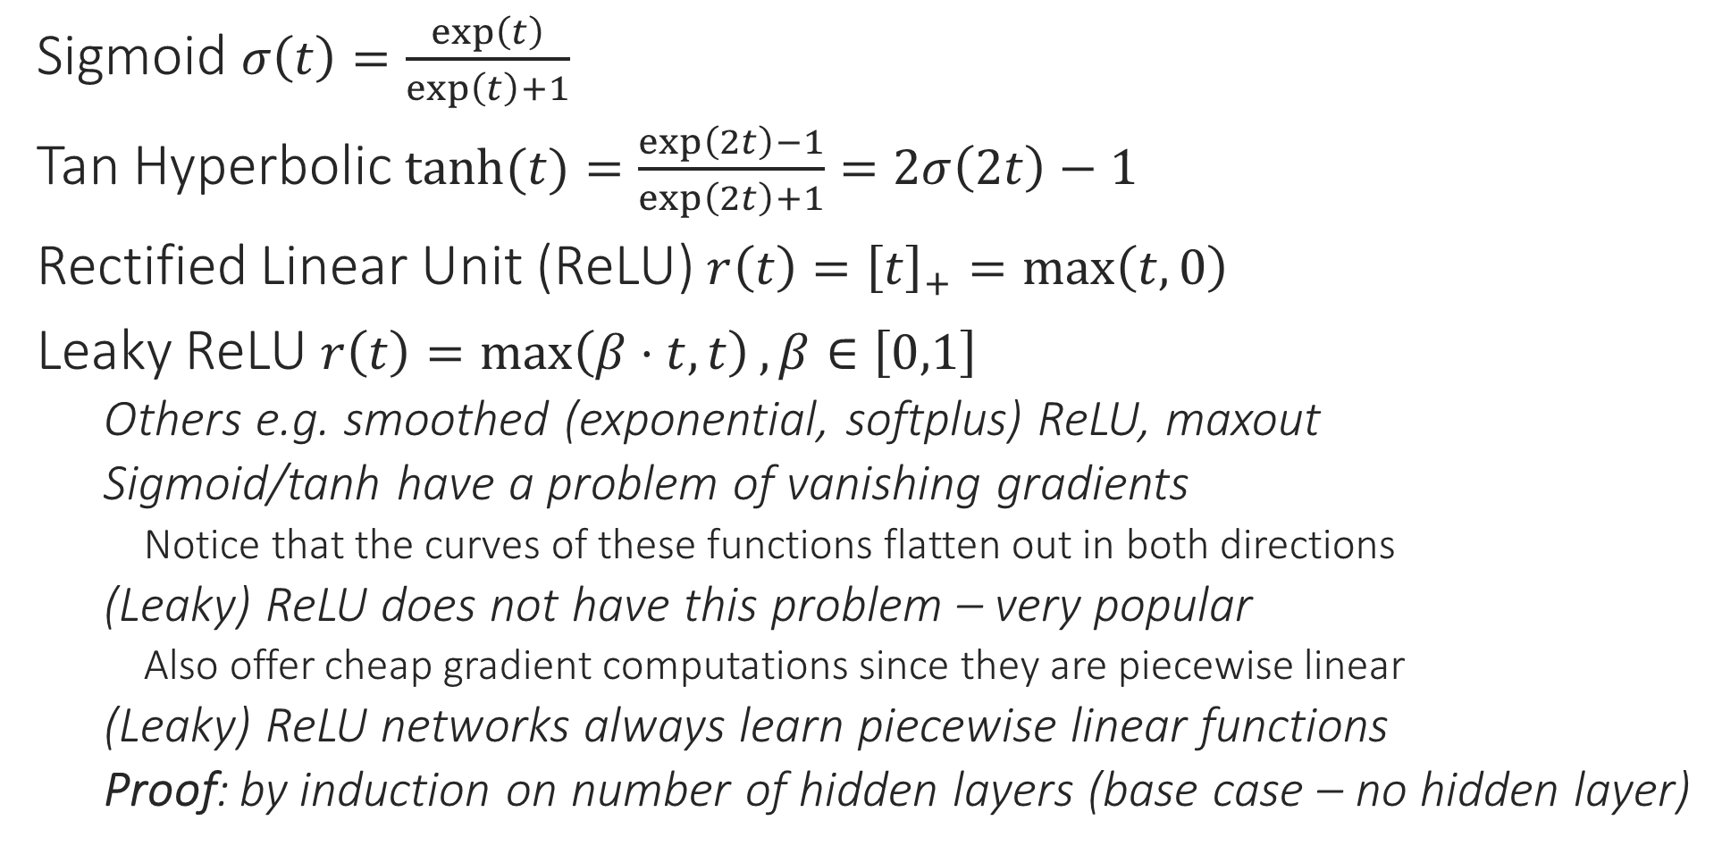
Common Activation Functions
1
1
0.5
Sigmoid $σ\left(t\right)=\frac{\exp\left(t\right)}{\exp\left(t\right)+1}$
Tan Hyperbolic $\tanh{(t)}=\frac{\exp\left(2t\right)−1}{\exp\left(2t\right)+1}=2σ\left(2t\right)−1$
Rectified Linear Unit (ReLU) $r\left(t\right)={\left[t\right]}_{+}=\max\left(t,0\right)$
Leaky ReLU $r\left(t\right)=\max\left(β⋅t,t\right),β∈\left[0,1\right]$
Others e.g. smoothed (exponential, softplus) ReLU, maxout
Sigmoid/tanh have a problem of vanishing gradients
Notice that the curves of these functions flatten out in both directions
(Leaky) ReLU does not have this problem – very popular
Also offer cheap gradient computations since they are piecewise linear
(Leaky) ReLU networks always learn piecewise linear functions
Proof: by induction on number of hidden layers (base case – no hidden layer)
0
0
1
-1
1
0
0
-1
Output layer neurons are usually given a task-specific activation e.g. identity for regression problems, sign for binary/multilabel classification problems, softmax for multiclassification problems

Slide 8
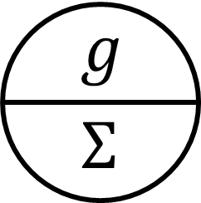
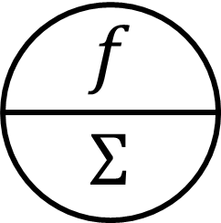
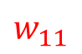
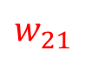
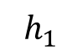
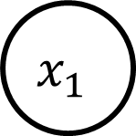
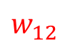
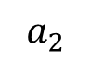
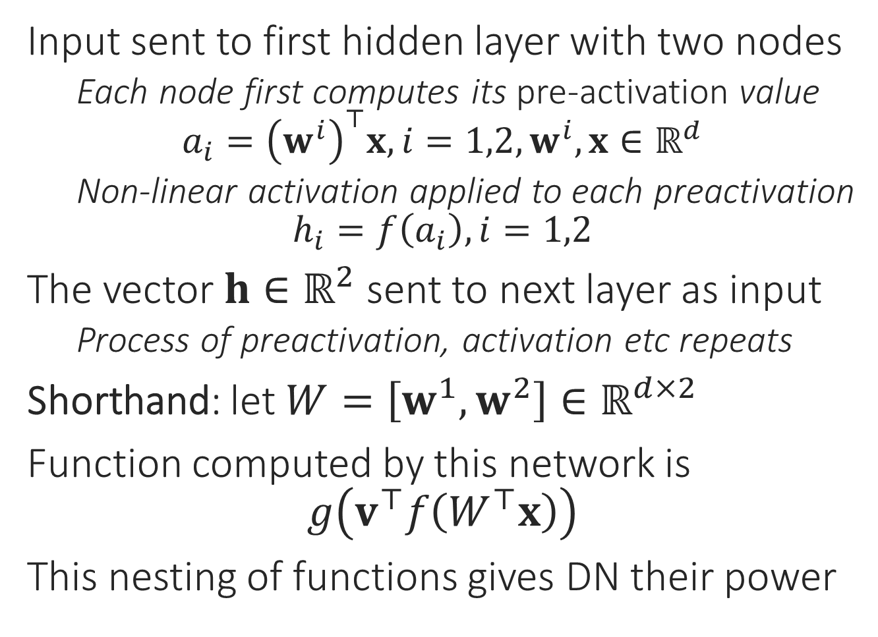
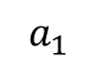
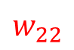
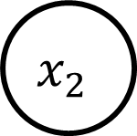
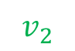
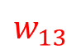
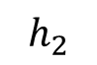
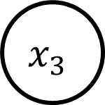
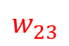
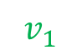
Toy Example
Input sent to first hidden layer with two nodes
Each node first computes its pre-activation value $a_{i}={\left(w^{i}\right)}^{⊤}x,i=1,2,w^{i},x∈ℝ^{d}$
Non-linear activation applied to each preactivation
$$h_{i}=f\left(a_{i}\right),i=1,2$$
The vector $h∈ℝ^{2}$ sent to next layer as input
Process of preactivation, activation etc repeats
Shorthand: let $W=\left[w^{1},w^{2}\right]∈ℝ^{d×2}$
Function computed by this network is $g\left(v^{⊤}f\left(W^{⊤}x\right)\right)$
This nesting of functions gives DN their power
$$v_{1}$$
$$v_{2}$$
$$h_{1}$$
$$h_{2}$$
$$a_{1}$$
$$a_{2}$$
$$w_{12}$$
$$w_{13}$$
$$w_{21}$$
$$w_{22}$$
$$w_{11}$$
$$w_{23}$$
$$x_{1}$$
$$x_{2}$$
$$x_{3}$$

Slide 9

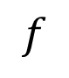
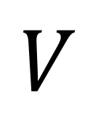

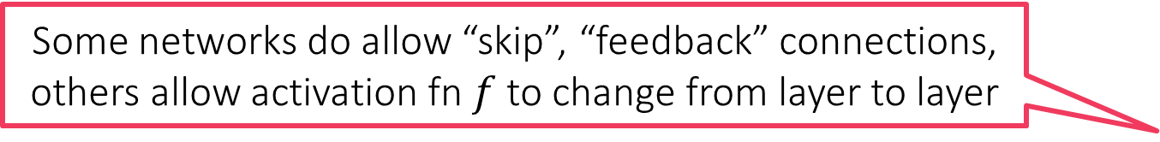
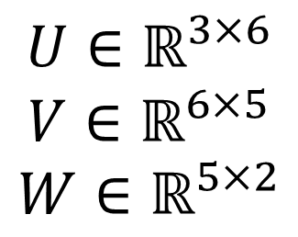


Feedforward Deep Networks
Some networks do allow “skip”, “feedback” connections, others allow activation fn $f$ to change from layer to layer
This architecture is often called a Multi-layered perceptron
$$f$$
$$f$$
One output node needed for binary classfn, regresn, more for multi-label/class
$$W$$
Cannot skip layers in classical FF networks
No “reverse” links allowed
$$V$$
Connections b/w layers usually “dense” – all pairs connected
$$U∈ℝ^{3×6}$$
$$V∈ℝ^{6×5}$$
$$W∈ℝ^{5×2}$$
$$U$$
All weights are learnt
$$f\left(W^{⊤}f\left(V^{⊤}f\left(U^{⊤}x\right)\right)\right)$$

Slide 10


Deep Networks
Strictly speaking, NN are parameterized models (connection weights are the parameters) but, they are frequently over parameterized – millions of parameters so almost as good (bad) as non-parametric – bulky models, long train + test times
Output layer
The layered architecture is what makes deep networks “deep”
Lower layers can be interpreted as computing useful features
Networks that learn polynomial etc features exist too – Sum Product Networks (SPN)
Last layer exploits all this hard work to learn a good linear model over them – can have any no. of layers, any no. of nodes in each layer
Kernels throw a large (often infinite) number of features at a problem, deep networks instead try to learn a small number of problem specific features
Easier said that done though ☺
A network having a linear activation function in hidden layers is useless since such a network can only learn a linear function in input
Can collapse, replace all hidden layers with a single connection from i/p to o/p
Even (leaky) ReLU are piecewise linear, not linear – non-linearity is essential
Hidden layer
$$φ\left(x\right)$$
Hidden layer
Input layer

Slide 11

Deep Networks Learn Features
We know what are expected outputs of the o/p layer (they are the train labels). So we say that the o/p layer is “visible”
Hidden representations make it easier for a linear model to perform well
Hidden layers compute latent or “hidden” representations not supplied with train data
Input layer is fed with train features which are also “visible” in train data

Slide 12
Some General Comments
Deep networks are universal i.e. all powerful
Like universal kernels, a “big enough” network can learn any function
Big enough can mean large number of “narrow layers” (i.e. each with few hidden nodes)
Big enough can mean just one impossibly wide hidden layer (shallow and wide)
In practice, coming up with an appropriate architecture is challenging
A lot of current progress in deep learning is due to people coming up with innovative architectures that do very well for various problems
No universal/well accepted rule for architecture design. Once an architecture is successful in a domain e.g. vision, people often reuse that same design
Often, even weights for lower layers reused – only top (few) layers retrained ☺
Training deep networks not very straightforward either
Availability of GPUs speeds things up but several heuristics like dropout, batch normalization etc required to do very well on challenging problems

Slide 13

Deep Learning or Wide Learning?
As stated before, NN are universal approximators when sufficiently big
(Cybenko 1989, Hornick 1991) show a single sufficiently wide layer (can need $Ω\left(2^{d}\right)$ nodes) can approx. “any” function i.e. 3 layer (depth 2) NN is universal
Lu et al (2017) show that $𝒪\left(d\right)$ layers each of $𝒪\left(d\right)$ width also suffice. However, the weights in the connections may have to become arbitrarily large
Large NN often overfit – simply memorize train data (just like RBF kernel)
Prevalent wisdom: large number of hidden nodes is the key to power of NN. Use this power with caution (regularization) to prevent overfitting
Domains where raw features do not have much structure e.g. RecSys, common to start with just one hidden layer and see if performance is acceptable
Domains where raw features are extremely well structured e.g. images, text, video, it is common to have several layers to learn new features patiently
Need to do a bit of trial and error to identify good number of layers, nodes

Slide 14









Toy “Proof” for Universality of Sigmoid NN
$$w={\left[1,1\right]}^{⊤}$$
$$b=2$$
$$w={\left[1,1\right]}^{⊤}$$
$$b=−2$$
A single neuron in the hidden layer can learn features (scores) of the form $σ\left(w^{⊤}x+b\right)$
Combining two such features in second hidden or o/p layer gives features like
Combining two such features in third hidden or o/p layer gives features like
This allows us to place Dirac-delta like features anywhere, approximate any function we want, as closely we want
Not a proper proof though
Refer to papers for proofs

Slide 15




Multi-output Deep Networks
Useful for multi-class/label classfn, ranking, vector regression
Let $t$ be pre-activations of o/p layer. For vector regression $f\left(t\right)=t$. For multilabel $f\left(t\right)=sign\left(t\right)$ (element-wise) often used
For multiclass, softmax popular. $z=f_{SM}\left(t\right)$ where $z_{i}=\frac{\exp\left(t_{i}\right)}{\sum_{j=1}^{K}{\exp\left(t_{j}\right)}}$
Good to normalize before use ${\tilde{t}}_{i}=t_{i}−\max_{j}{t_{j}}$ to avoid overflow problems. Note that Note that $f_{SM}\left(t\right)=f_{SM}\left(\tilde{t}\right)$

Slide 16


Loss Functions for Deep Learning
Exact definitions, conventions may vary. Always check your library documentation (Keras, PyTorch etc) to avoid errors. E.g. Keras expects labels for even multiclass problems to be a $\left\{0,1\right\}$ vector
Squared loss $ℓ_{LS}\left(\hat{y},y\right)={\left(\hat{y}−y\right)}^{2}$
Absolute difference $ℓ_{ABS}\left(\hat{y},y\right)=\left|\hat{y}−y\right|$
Squared/absolute loss most common for regression problems
Work well when ReLU/identity activation used in the output layer
Sigmoid/tanh do not give good gradients
Negative log-likelihood loss $ℓ_{NLL}\left(\hat{y},y\right)=−\log\left({\hat{y}}_{y}\right)$ where $y∈\left[K\right]$
Also called categorical cross entropy (CCE) – useful for multiclass problems
Binary CE $ℓ_{CE}\left(\hat{y},y\right)=−y⋅\log{\hat{y}}−\left(1−y\right)⋅\log\left(1−\hat{y}\right)$, $y∈\left\{0,1\right\}$
B/CCE popular for classification problems and most commonly used along with softmax activation for the output layer i.e. $\hat{y}=f_{SM}\left(t\right),t∈ℝ^{K}$
Hinge loss $ℓ_{Hinge}\left(\hat{y},y\right)={\left[1−y\hat{y}\right]}_{+}$ where $y∈\left\{−1,1\right\}$

Slide 17
Training Deep Networks
Preventing overfitting in deep network learning e.g. dropout
The backpropagation algorithm for multi-layer perceptrons
Notion of Jacobian – chain rule with Jacobians
Bookkeeping in backprop to avoid repeated computations

Slide 18







Training a Perceptron
Some texts may state that a perceptron is simply a linear model i.e. it cannot have a wrapper function around the linear model. We are using a broader definition of perceptron in our discussion
Recall that a perceptron is simply an activation function wrapped around a linear model i.e. $\hat{y}=f\left(\left\langle w,x\right\rangle \right)$ i.e. a gen-lin model
Given $\left(x^{1},y^{1}\right),…,\left(x^{n},y^{n}\right), x^{i}∈ℝ^{d}$ and loss fn $ℓ: ℝ×ℝ→ℝ_{+}$, we can train a perceptron by solving the following optimization problem $\arg{\min_{w∈ℝ^{d}}{\frac{1}{n}\sum_{i}^{n}{ℓ\left(f\left(\left\langle w,x^{i}\right\rangle \right),y^{i}\right)}}}=:\arg{\min_{w∈ℝ^{d}}{F\left(w\right)}}$
The training procedure is plain old gradient descent
However, this being a non-convex problem (due to $f$), requires more care
How to find a descent direction?
How to choose a step length?
How to detect convergence?
How to avoid overfitting?
Step lengths are decided using one of the techniques we have already studied in our optimization refresher e.g. $η_{t}=C/\sqrt{t}$ or an adaptive technique like NAG, Adagrad or Adam. Thus, we wont discuss those here again.
GRADIENT DESCENT
Initialize ${\text{w}}^{0}$
For $t=1, 2,…$
Obtain a descent direction $g^{t}$
Update $w^{t+1}←w^{t}−η_{t}⋅g^{t}$
Repeat until convergence or until tired
Note that our definition of a perceptron is effectively equal to a NN with no hidden layers i.e. depth 1 (not considered “deep” – only depth $≥2$ is deep). Let us see how to train a perceptron before seeing how deep NN are trained

Slide 19

Choosing a Descent Direction
Batch gradient (use chain rule) $g^{t}=∇F\left(w^{t}\right)=\frac{1}{n}\sum_{i=1}^{n}{ℓ^{′}\left(f\left(\left\langle w^{t},x^{i}\right\rangle \right),y^{i}\right)⋅f′\left(\left\langle w^{t},x^{i}\right\rangle \right)}⋅x^{i}$
Mini-batch variant more popular: choose a mini-batch $I_{1}^{t},I_{2}^{t},…,I_{B}^{t}∼\left[n\right]$ $g^{t}=\frac{1}{B}\sum_{j=1}^{B}{ℓ^{′}\left(f\left(\left\langle w^{t},x^{I_{j}^{t}}\right\rangle \right),y^{i}\right)⋅f′\left(\left\langle w^{t},x^{I_{j}^{t}}\right\rangle \right)}⋅x^{I_{j}^{t}}$
DL techniques usually decide batch size based on memory available
Popular choice – randPerm (similar to the strategy we used for SDCM)
Choose a random permutation $σ$ of $\left[n\right]$. First batch is $σ\left(1\right),…,σ\left(B\right)$, second batch is $σ\left(B+1\right),…,σ\left(2B\right)$, repeat for $\left\lceil n/B\right\rceil$ batches till all points exhausted
This is called one epoch. Note: last batch may contain less than $B$ points if $n \% B≠0$
For next epoch, choose a new random permutation and repeat for blah epochs

Slide 20

How to prevent overfitting?
Method 1: Regularize the weights
1.1: add an explicit regularization term $\arg{\min_{w∈ℝ^{d}}{F\left(w\right)}}+λ⋅{\left\|w\right\|}_{2}^{2}$
1.2: don’t allow any weight to get big (clip them) $\arg{\min_{{\left\|w\right\|}_{∞}<r}{F\left(w\right)}}$
Most libraries implement these strategies themselves e.g. weight clipping
Sometimes even gradient coordinates are clipped to stabilize training
Method 2: Deliberately inject noise into the labels
For binary classification $y^{i}=0→y^{i}=ε$, $y^{i}=1→y^{i}=1−ε$
For regression problems, $y^{i}→y^{i}+ε^{i}$, where $ε^{i}∼𝒩\left(0,σ^{2}\right)$
Unlikely that a NN with limited # of nodes would be able to memorize noise
For NN setting these are just heuristics but when applied to nicer settings (e.g. linear models), label noise can be shown to be equivalent to regularization

Slide 21

How to prevent overfitting?
Method 3: Learn Sparse Models
3.1 Learn a NN that has sparse (instead of dense) connections b/w layers
See Frankle-Carbin (ICLR 2019) – The Lottery Ticket Hypothesis
3.2 Parameter sharing: force some of the weights to take the same value by adding constraints of the form $w_{i}=w_{j}$
Convolutional NN do this implicitly and are very successful
3.3 Dropout: Implicitly trains on multiple sparse networks in parallel
While executing a GD update, randomly remove edges or entire nodes from network so they do not get updated in that iteration. Put them back in after update is over
Can again be shown to be equivalent to $L_{2}$ regularization in “nice” settings
Method 4: Validation
Use early stopping – do not rely on training loss but rather performance on a held-out (or k-fold) validation set to decide when to stop training

Slide 22

Dropout
During training, before applying mini-batch gradient descent
Randomly mark each input node (e.g. choose each with prob 20%)
Randomly mark each hidden node (e.g. choose each with prob 50%)
Remove marked nodes, and corresponding edges from the network
Apply mini-batch gradient descent (or backprop) to the remaining network
Backprop is GD applied to multilayer perceptrons – will study this next
NAG, AdaGrad, Adam etc can be used along with dropout as usual
Dropout at test time: scale the (post-activation) output of each node in the NN with the prob with which that node would have been spared from marking
An approximation but a scalable one that gives acceptable performance in practice
$𝔼\left[h\right]=h⋅ℙ\left[\text{not} \text{drop}\right]+0⋅ℙ\left[\text{drop}\right]=h⋅\left(1−p\right)$ ($p=0.2/0.5$ for ip/hidden nodes)
Forces nodes to learn to work in absence of other nodes – robust!
Side effect is slightly faster training and regularization

Slide 23



















Dropout at Work
$$id$$
$$id$$
$$id$$
$$id$$
$$id$$
16%
4%
4%
16%
16%
$$id$$
$$x_{1}$$
$$x_{2}$$
$$x_{2}$$
$$x_{1}$$
$$x_{1}$$
$$x_{2}$$
$$x_{1}$$
$$x_{2}$$
$$id$$
$$id$$
$$id$$
$$id$$
$$id$$
4%
4%
4%
4%
28%
$$x_{1}$$
$$x_{2}$$
$$x_{1}$$
$$x_{2}$$
$$x_{1}$$
$$x_{2}$$
In this toy example, 28% NN have no i/p nodes or no path connecting at least one i/p node to the o/p node i.e. cannot apply GD to them. For large networks, it is unlikely that sampling will result in such a disconnected network. In practice a large fraction of nodes do get retained

Slide 24






Backprop for Multi-output Deep Networks
This network learns the function $$g\left(V^{⊤}f\left({\left(W^{2}\right)}^{⊤}f\left({\left(W^{1}\right)}^{⊤}x\right)\right)\right)$$
$$g\left(t\right)=z$$
Popular output-layer activation
For vector regression $g\left(t\right)=t$
For multilabel $g\left(t\right)=sign\left(t\right)$
For multiclass, softmax $z=g_{SM}\left(t\right)$, $z_{i}=\frac{\exp\left(t_{i}\right)}{\sum_{j=1}^{K}{\exp\left(t_{j}\right)}}$
$$V$$
$$W^{2}$$
$$W^{1}$$

Slide 25





Training Multilayer NN
For sake of simplicity, use a single output NN with identity o/p layer activation to study backprop. Similar procedures apply even if multiple outputs with softmax o/p layer activation etc etc
$d$ i/p, $L−1$ hidden layers
$k_{l}$ nodes in $l$-th layer
$k_{1}=d$ nodes in i/p layer
$W^{l}∈ℝ^{k_{l−1}×k_{l}}$ weights from layer $l−1$ to $l$
$v∈ℝ^{k_{L}}$ weights from layer $L$ to output node
$h^{l}∈ℝ^{k_{l}}$ o/p by layer $l$
$\hat{y}$ output of the network
$h^{l}=f\left({\left(W^{l}\right)}^{⊤}h^{l−1} \right)$
$f\left(u\right)=\left[f\left(u_{1}\right),…,f\left(u_{k}\right)\right]$
$\hat{y}=\left\langle v,h^{L}\right\rangle$
$$v$$
We will learn the backpropagation (backprop/BP) algorithm to train deep networks. BP is essentially chain rule + intelligent bookkeeping. Despite several proposed innovations, BP is still the defacto training method for DL
Intelligent bookkeeping essential to allow gradients to be computed and stored in optimal space and time. Recall that we had used intelligent bookkeeping to reduce time of SDCM from $𝒪\left(nd\right)$ to $𝒪\left(n\right)$
$$W^{2}$$
$$W^{1}$$

Slide 26

Chain Rule Revisited
Let $x=f\left(y\right), y=g\left(z\right),z=h(w)$ with $x,y,z,w∈ℝ$, $f,g,h: ℝ→ℝ$
i.e. $x=f\left(g\left(h\left(w\right)\right)\right)$. Chain rule $\frac{dx}{dw}=\frac{dx}{dy}⋅\frac{dy}{dz}⋅\frac{dz}{dw}=f^{′}\left(y\right)⋅g^{′}\left(z\right)⋅h^{′}\left(w\right)$
To compute $\frac{dx}{dw}$ at a point $w=w^{0}$ the above rule gives us a simple algo
First compute $z^{0}=h\left(w^{0}\right),y^{0}=g\left(z^{0}\right)$
Then compute $r=h^{′}\left(w^{0}\right),q=g^{′}\left(z^{0}\right),p=f^{′}\left(y^{0}\right)$
Finally compute $\frac{dx}{dw}=p⋅q⋅r$
Backprop uses the multivariate version of this rule
Recall that if $x=f\left(y\right)$ where $x∈ℝ,y∈ℝ^{q}$ and $f: ℝ^{q}→ℝ$ we have notion of gradient of the function that gives us $\frac{dx}{dy}=∇f\left(y\right)∈ℝ^{1×q}$
(New) Convention: treat gradients as row vectors to make notation clean

Slide 27


Multivariate Chain Rule
In general if we have a function $f:ℝ^{p}→ℝ^{m×n}$, its Jacobian is a 3rd order tensor (a 3D matrix) of dimensionality $ℝ^{m×n×p}$. If $g:ℝ^{p×q}→ℝ^{m×n}$, its Jacobian is a 4th order tensor (a 4D matrix) of dimensionality $ℝ^{m×n×p×q}$. In general very easy to predict dimensionality of Jacobian
If we now have a multivariate function $x=f\left(y\right)$ where $x∈ℝ^{p},y∈ℝ^{q}$ and $f: ℝ^{q}→ℝ^{p}$, then we have the notion of the Jacobian
Think of $f\left(y\right)={\left[f_{1}\left(y \right),…,f_{p}\left(y\right)\right]}^{⊤}$ as a vector of $p$ real-valued functions $\frac{dx}{dy}≜J^{f} where ,J_{ij}^{f}=\frac{dx_{i}}{dy_{j}} i.e. J^{f}=\left[\begin{matrix}∇f_{1}\left(y\right) \\ ⋮ \\ ∇f_{p}\left(y\right)\end{matrix}\right]∈ℝ^{p×q}$
All that Jacobian does is consider $f_{i}\left(⋅\right):ℝ^{q}→ℝ,i=1,…,p$ separately, find their (row) gradient vectors, and stack them vertically as a matrix
If $x=f\left(y\right), y=g\left(z\right)$, $x∈ℝ,y∈ℝ^{q},z∈ℝ^{r}$ $f: ℝ^{q}→ℝ,g: ℝ^{r}→ℝ^{q}$ (actually happens in NN) then chain rule changes its form
$$\frac{dx}{dz_{j}}=\sum_{i=1}^{q}{\frac{dx}{dy_{i}}⋅\frac{dy_{i}}{dz_{j}}}$$
Yes, it is quite simply a tensor whose dimensionality is the output dimensionality of the function “times” the input dimensionality of the function

Slide 28


Multivariate Chain Rule
We may verify that Jacobian notation does preserve old results. Consider a function $x=f\left(y\right)$ where $x∈ℝ^{p},y∈ℝ^{q}$.
If $p=q=1$ (basic case), Jacobian is simply a $1×1$ matrix (a real number)
If $p=1$ and $q>1$ (real valued fn on vector space), Jacobian is a row vec
If $p>1$ and $q=1$ and no $w$ (vector valued function on the real line), Jacobian becomes a column vector
However, the above is simplified greatly by use of Jacobians $\frac{dx}{dz_{j}}=\sum_{i=1}^{q}{\frac{dx}{dy_{i}}⋅\frac{dy_{i}}{dz_{j}}}=∇f\left(y\right)⋅J^{g}∈ℝ^{1×r}$
where $J^{g}$ is the Jacobian of $g$ and $∇f\left(y\right)$ is the Jacobian (gradient) of $f$
Jacobian of real-valued functions is simply their gradient (row) vector
Notion of Jacobian allows us to apply chain rule to very general settings
If $x=f\left(y\right), y=g\left(z\right),z=h(w)$ with $x∈ℝ^{p},y∈ℝ^{q},z∈ℝ^{r},w∈ℝ^{s}$ $\frac{dx}{dw}=J^{f}⋅J^{g}⋅J^{h}$
Very elegant and mimics the real-valued case $\frac{dx}{dw}=f^{′}\left(y\right)⋅g^{′}\left(z\right)⋅h^{′}\left(w\right)$
If we are careful with dimensions, Jacobians greatly simplify life

Slide 29





Back to Backpropagation
$η$ is decided using a step length calculation technique e.g. Adam etc
NN output is $\hat{y}=v^{⊤}f\left({\left(W^{2}\right)}^{⊤}f\left({\left(W^{1}\right)}^{⊤}x\right)\right)$
We wish to minimize the loss on train data
$F\left(v,W^{2},W^{1}\right)=\sum_{i=1}^{n}{ℓ\left({\hat{y}}^{i},y^{i}\right)}=\sum_{i=1}^{n}{ℓ^{i}}$
We want to apply GD updates of the form $v←v−η⋅\frac{∂F}{∂v}$
$W^{i}←W^{i}−η⋅\frac{∂F}{∂W^{i}}$ for $i=1,2$
Thus, all we are left to calculate are $\frac{∂ℓ^{i}}{∂v},\frac{∂ℓ^{i}}{∂W^{2}},\frac{∂ℓ^{i}}{∂W^{1}}$
$$v$$
$$W^{2}$$
$$W^{1}$$

Slide 30

Back to Backpropagation
First is easy as we have $ℓ^{i}=ℓ\left({\hat{y}}^{i},y^{i}\right)$ and ${\hat{y}}^{i}=v^{⊤}h^{2,i}$ where $h^{2,i}$ is (post-activation) o/p of 2nd hidden layer on $i$-th data point $\frac{dℓ^{i}}{dv}=\frac{dℓ^{i}}{d{\hat{y}}^{i}}⋅\frac{d{\hat{y}}^{i}}{dv}=ℓ^{′}\left({\hat{y}}^{i},y^{i}\right)⋅{\left(h^{2,i}\right)}^{⊤}$
Verify that $\frac{dℓ^{i}}{dv}$ does have dimensions of $v^{⊤}$ and can hence be used in GD updates for $v$
Recall that we switched to row convention for gradients so this makes sense
$$v$$
$$W^{2}$$
$$W^{1}$$

Slide 31

Back to Backpropagation
$\frac{dℓ^{i}}{dW^{2}}$ is more fun: $ℓ^{i}$ depends only on ${\hat{y}}^{i}$ so
$\frac{dℓ^{i}}{dW^{2}}=\frac{dℓ^{i}}{d{\hat{y}}^{i}}⋅\frac{d{\hat{y}}^{i}}{dW^{2}}=ℓ^{′}\left({\hat{y}}^{i},y^{i}\right)⋅\frac{d{\hat{y}}^{i}}{dW^{2}}$
${\hat{y}}^{i}=v^{⊤}h^{2,i}$ depends on $v$ and $h^{2,i}$
$\frac{d{\hat{y}}^{i}}{dW^{2}}=\frac{d{\hat{y}}^{i}}{dh^{2,i}}⋅\frac{dh^{2,i}}{dW^{2}}+\frac{d{\hat{y}}^{i}}{dv}⋅\frac{dv}{dW^{2}}$ but $\frac{dv}{dW^{2}}=0$
Since we assume $v$ is not a function of $W^{2}$
$\frac{dℓ^{i}}{dW^{2}}=ℓ^{′}\left({\hat{y}}^{i},y^{i}\right)⋅\frac{d{\hat{y}}^{i}}{dh^{2,i}}⋅\frac{dh^{2,i}}{dW^{2}}$
$=ℓ^{′}\left({\hat{y}}^{i},y^{i}\right)⋅v^{⊤}⋅\frac{dh^{2,i}}{dW^{2}}$ (since ${\hat{y}}^{i}=v^{⊤}h^{2,i}$)
Now we have to find out $dh^{2,i}/dW^{2}$
$$v$$
$$W^{2}$$
$$W^{1}$$

Slide 32


Back to Backpropagation
Overall we have $\frac{dℓ^{i}}{dW^{2}}=ℓ^{′}\left({\hat{y}}^{i},y^{i}\right)⋅v^{⊤}⋅\frac{dh^{2,i}}{da^{2,i}}⋅\frac{da^{2,i}}{dW^{2}}$. The dimensionality of $\frac{dℓ^{i}}{dW^{2}}$ is $ℝ^{1×1}⋅ℝ^{1×k_{3}}⋅ℝ^{k_{3}×k_{3}}⋅ℝ^{k_{3}×k_{3}×k_{2}}=ℝ^{1×k_{3}×k_{2}}$ which is as expected
We have $h^{2,i}=f\left({\left(W^{2}\right)}^{⊤}h^{1,i}\right)=f\left(a^{2,i}\right)$
$a^{2,i}$ are the pre-activations of second layer
Thus, we have $\frac{dh^{2,i}}{dW^{2}}=\frac{dh^{2,i}}{da^{2,i}}⋅\frac{da^{2,i}}{dW^{2}}$
$\frac{dh^{2,i}}{da^{2,i}}=diag\left(f^{′}\left(a_{1}^{2,i}\right)…f^{′}\left(a_{k_{3}}^{2,i}\right)\right)∈ℝ^{k_{3}×k_{3}}$
This is so because $h^{2,i}=f\left(a^{2,i}\right)$
$\frac{da^{2,i}}{dW^{2}}$ on the other hand, is a 3D tensor (matrix) of dimensionality $k_{3}×k_{3}×k_{2}$
This is why TensorFlow is named so ☺
$$v$$
$$W^{2}$$
$$W^{1}$$

Slide 33

Bookkeeping in Backprop
Thus, we derive the update (steps for calculating $\frac{dℓ^{i}}{dW^{1}}$ similar & omitted) $\frac{dℓ^{i}}{dv}=ℓ^{′}\left({\hat{y}}^{i},y^{i}\right)⋅{\left(h^{2,i}\right)}^{⊤}$, $\frac{dℓ^{i}}{dW^{2}}=ℓ^{′}\left({\hat{y}}^{i},y^{i}\right)⋅v^{⊤}⋅\frac{dh^{2,i}}{da^{2,i}}⋅\frac{da^{2,i}}{dW^{2}}$, and $\frac{dℓ^{i}}{dW^{1}}=ℓ^{′}\left({\hat{y}}^{i},y^{i}\right)⋅v^{⊤}⋅\frac{dh^{2,i}}{da^{2,i}}⋅\frac{da^{2,i}}{dh^{1,i}}⋅\frac{dh^{1,i}}{da^{1,i}}⋅\frac{da^{1,i}}{dW^{1}}$
Terms such as $ℓ^{′}\left({\hat{y}}^{i},y^{i}\right)$, $\frac{dh^{2,i}}{da^{2,i}}$ used repeatedly in multiple expressions
TensorFlow, PyTorch do bookkeeping to avoid repeated computation
Save time but also use up a lot of memory (which GPUs don’t always have ☹)
Note: $\frac{dh^{l,i}}{da^{l,i}}=diag\left(f^{′}\left(a_{1}^{l,i}\right)…f^{′}\left(a_{k_{l+1}}^{l,i}\right)\right)$, if $f^{′}$ is small (e.g. sigmoid), then the terms multiplied together may become very small – vanishing gradients
One reason why ReLU etc preferred – do not have vanishing gradients issue

Slide 34
Generative Neural Networks
So far we have looked at networks that solve prediction problems like (binary,multiclass/label)classification, regression etc
Neural networks can also be used to learn generative models
Can be used for dim. redn. as well as to generate new data points
(Variational) Autoencoders (Kingma & Welling 2013, Rezende et al. 2014) and Generative adversarial networks (Goodfellow et al 2014) are two popular generative models that use neural networks
Will describe them using feedforward networks but they can be formed out of CNNs or RNNs as well

Slide 35











Autoencoders
In PCA, a low dim latent variable $z$ generated the data as $x=Wz+ε$
Note: a linear map (factor loading matrix) was applied to $z$ to obtain data
If we find $W$, then we could recover the low-dim $z=W^{⊤}x$
PCA offers the best reconstruction error ${\left\|x−WW^{⊤}x\right\|}_{2}^{2}$
Autoencoders do this using non-linear maps
An “encoder” converts data to a latent representation $h=e(x)$
A “decoder” produces a reconstruction $r=d(h)$
Want to minimize loss $ℓ\left(d\left(h\right),x\right)=ℓ\left(d\left(e\left(x\right)\right),x\right)$
$$id$$
$$id$$
$$id$$
$$id$$
$$W^{2}$$
$$\text{id}$$
$$\text{id}$$
$$\text{id}$$
$$W^{1}$$
E.g., Euclidean error
$$ℓ\left(d\left(e\left(x\right)\right),x\right)={\left\|d\left(e\left(x\right)\right)−x\right\|}_{2}^{2}$$
Can use backprop to train AE NN

Slide 36






Autoencoders
$$id$$
$$id$$
$$id$$
$$id$$
Decoder
PCA can be thought of as a linear autoencoder
Just like PCA, autoencoders are trained to lower reconstruction error using backpropagation
The “hourglass” architecture very popular in AE
Gradually decreases dimensionality of data
However, a monotonic decrease not necessary
E.g. 784 →1000→500→250→30→250→500→1000→784 on MNIST data (Hinton and Salakhutdinov)
In fact some autoencoders do not decrease dim at all
Called overcomplete autoencoders. Recall that as in kernel PCA, goal may be to find better features not fewer features
Autoencoders can overfit badly too – just memorize data and offer no useful dim red on test data
Various techniques to regularize AE
$${\tilde{W}}^{1}$$
“Bottleneck”. For overcomplete AE, bottleneck may have more neurons than input layer. For undercomplete neurons, less neurons than input layer in bottleneck layer so dim redn
$${\tilde{W}}^{2}$$
Encoder
$$W^{2}$$
Indeed, with overcomplete AE, we can have zero reconstruction error by simply having all hidden nodes use identity activation and making sure that $W^{i}=I$. However, such an AE has not learnt anything useful
$$W^{1}$$

Slide 37

Regularized Autoencoders
Techniques similar to we have studied before are used
Method 1 (Denoising AE) Add noise to i/p feat but expect original feat at o/p $ℓ\left(d\left(e\left(x+ε\right)\right),x\right)={\left\|d\left(e\left(x+ε\right)\right)−x\right\|}_{2}^{2}$, $ε$ is noise added to input
Method 2 (Sparse AE) Force the bottleneck layer activations to be sparse
For every data point, penalize the AE if the vector $e\left(x^{i}\right),i=1…n$ has lots of non-zeros
This trick can allow even overcomplete AE to be trained without risk of overfitting
Method 3 (Variational AE) Force bottleneck layer activations to fit to a Gaussian
Find $μ,Σ$ and train encoder and decoder $e,d$ such that not only does reconstruction loss become small but also the latent representations $e\left(x^{i}\right),i=1…n$ are well approximated by the Gaussian $𝒩\left(μ,Σ\right)$
Can make this more powerful by taking mixture of Gaussians instead of a single Gaussian
A variational AE (VAE) can easily generate new samples
Sample $z^{new}∼𝒩\left(μ,Σ\right)$ and use decoder $d\left(z^{new}\right)$ to obtain a new data point

Slide 38
Generative Adversarial Networks
Do not aim to offer good reconstruction error – sole aim is to produce new data points that are realistic and distributed as training data points
E.g. given tons of cat images, generate new ones (as if there weren’t enough of them around already) but make sure the new ones do look like cats
Uses two networks to perform this – a generator network which attempts to generate new samples, and a discriminator network which attempts to distinguish samples generated by the generator from actual training data
If the discriminator is unable to tell the generator’s samples from actual data then this means the generator has learnt to generate realistic data (or else that the discriminator is weak and needs to be strengthened)
Interesting interpretation of GAN tells us that the discriminator supplies the generator with the gradients it needs to train itself
Thus, instead of calculating backprop gradients from data, another NN (in this case the discriminator) “learns” the gradients for the generator ☺

Slide 39






GANs – a toy depiction
$$ℙ\left[\text{image} \text{is} \text{genuine}\right]$$
$G,D$ play a game to defeat the other
$D$ tries to predict whether data given to it is real train data or fake samples
Wants $ℙ_{D}\left[x^{i}\right]→1$ and $ℙ_{D}\left[G\left(z^{i}\right)\right]→0$
$G$ wants to generate very realistic samples and thus confuse $D$
Wants $ℙ_{D}\left[G\left(z^{i}\right)\right]→1$
A single loss function is used
$ℒ\left(D,G\right)=\log\left(D\left(x\right)\right)+\log\left(1−D\left(G\left(z\right)\right)\right)$
$D$ tries to maximize this loss function
$G$ tries to minimize this loss function
$D$ Discriminator
$x∈$ Train Set
$G$ Generator
$$z∈𝒩\left(0,I_{k}\right)$$

Slide 40
Convolutional Networks
Need for convolutional networks (weight sharing, local features)
Notions of convolutions and pooling
Creating multi-layered convolutional networks

Slide 41

Feedforward Networks can be massive
Fully connected layers are powerful
Allow all possible combinations of input dims to create new features which are functions of any subset of $x_{1},x_{2},…,x_{d}$
New features of the form $f\left(w^{⊤}x\right)$
Also very unnecessary for apps where input has lots of structure
Make networks very bulky – e.g. the AE
784 →1000→500→250→30→250→500→1000→784
needs 2.8 million edge weights to be learnt
From only 60 thousand data points ☹
Also require tons of data to train so many edge weights otherwise NN may overfit

Slide 42
Structured Data needs Local Features
EYE
EYE
MOUTH
Highly unlikely that top left and bottom right pixels would need to be considered together right at the first hidden layer to detect edges
Only neighboring pixels need to talk to each other to detect edges. Also, edge detection happens via “filters” – same filter needs to be applied everywhere
Then, need to aggregate info to detect structures
Then, need to detect even higher level features
Distant pixels are jointly considered, but at a much later stage (deeper layer)

Slide 43
Convolution Operation
Convolutions are at the heart of signal processing and CNNs
Convolutions create layers which are sparsely connected
Only 18 edges, fully connected layer would have had 48 edges

Slide 44
Convolution Operation
Convolutions are at the heart of signal processing and CNNs
Convolutions create layers which are sparsely connected
On top of that they force equality constraints among weights in that layer
All green edges forced to have the same weight, all red edges forced to have the same weight, all blue edges …
So effectively only 3 edge weights to be learnt for this layer!
A fully connected layer would have had 48 edges

Slide 45


Convolution Operation
The formal name for such an operation which sweeps a function (in this case $f\left(w^{⊤}⋅\right)$ across a signal or an array is convolution. The vector $w$ is often called the kernel of the convolution – don’t confuse this with Mercer kernels though!
Convolutions have been around in image processing for decades. Earlier, people used to painstakingly design the kernels by hand (e.g. Canny filters) but CNNs allow us to learn the kernel of the convolution itself.
Convolutions are at the heart of signal processing and CNNs
Convolutions create layers which are sparsely connected
On top of that they force equality constraints among weights in that layer
Doing so efficiently and cleverly so that we don’t land up with a nasty constrained optimization problem is the key to the success of CNNs
$h_{i}=f\left(x_{i}⋅w_{1}+x_{i+1}⋅w_{2}+x_{i+2}⋅w_{3}\right)$ i.e. $h_{i}=f\left(\sum_{j=1}^{3}{x_{i+j−1}⋅w_{j}}\right)$
True, the idea is to allow difficult problems to be solved with a customized filter that works best for that problem. However, handcrafted filters may still offer good results for simple problems (and offer faster training since learning filters is not an easy task – the backprop becomes complicated)

Slide 46
2D Convolutions
Convolutions make sense for 2D, 3D, nD data as well
A fully conn. layer would’ve needed 576 weights. A conv. needs only 9 weights
Such local operations are exactly what we need for detecting local patterns
Edges, boundaries, textures
Can apply convolutions to 3D layers as well
E.g. Video data is 3D

Slide 47

Convolutional Neural Network
Popular where the raw data has strong spatial structure e.g. images have 2D structure, text has linear structure, video has 3D structure
Greatly reduces the number of parameters to be learnt
Layers sparsely connected and aggressive parameter sharing
Note: notion of “convolution” used in CNNs is non-standard
Standard notion of convolution of two vectors $u,v∈ℝ^{n}$ is another vector $s∈ℝ^{n}$ denoted as $s=u∗v$ such that $s_{i}=\sum_{j=1}^{n}{u_{j}{⋅v}_{i−j}}$
However, CNNs use the definition ${\left(u∗v\right)}_{i}=\sum_{j=1}^{n}{u_{i+j}{⋅v}_{j}}$
In signal processing literature this operation is actually called cross-correlation

Slide 48




Pooling Operations
Reduce sensitivity of the network to small shifts/errors in image
Max-pooling and average pooling most common
“Stride” length – number of nodes after which a new “pool” is started. Stride = 3 here
$$p$$
$$p$$
$$p_{max}\left(h_{1},h_{2},h_{3}\right)=\max\left\{h_{1},h_{2},h_{3}\right\}$$
$$p_{avg}\left(h_{1},h_{2},h_{3}\right)=\frac{1}{3}\left(h_{1}+h_{2}+h_{3}\right)$$

Slide 49





Simple Operations using Conv and Pool
Max Pooling (stride 1x2)
We may verify that 2x2 stride leads to too much info loss
Raw Image
Kernels
Convolved Image
$$0$$
$$−1$$
Detects horizontal edges!
$$=+1$$
$$=+0.5$$
$$=0$$
$=0$ (padded)
$$=−0.5 \\ =−1$$
$$0$$
$$−1$$
Detects vertical edges!
Max Pooling (stride 2x1)
Images are often padded with zero pixels so that convolved image is of same size

Slide 50
Pooling and Strides – an example
1 | 2 | 3 | 4 | 5
9 | 8 | 7 | 6 | 0
0 | 2 | 4 | 6 | 8
2 | 3 | 4 | 5 | 1
6 | 7 | 8 | 9 | 0
0
0
0
0
0
0
2 x 2 max pool
2 x 1 stride
9 | 8 | 7 | 6 | 5
3 | 4 | 6 | 8 | 8
7 | 8 | 9 | 9 | 0
0 | 0 | 0 | 0 | 0
Padding

Slide 51
Pooling and Strides – an example
1 | 2 | 3 | 4 | 5
9 | 8 | 7 | 6 | 0
0 | 2 | 4 | 6 | 8
2 | 3 | 4 | 5 | 1
6 | 7 | 8 | 9 | 0
0
0
0
0
0
0
2 x 2 max pool
2 x 1 stride
9 | 8 | 7 | 6 | 5
3 | 4 | 6 | 8 | 8
7 | 8 | 9 | 9 | 0
9 | 7 | 5
9 | 7 | 8
3 | 6 | 8
7 | 9 | 1
7 | 9 | 1
2 x 2 max pool
1 x 2 stride
0 | 0 | 0 | 0 | 0
Padding

Slide 52
Using CNNs in Computer Vision
3 kernels used to create 3 channels
Kernels learnt using backprop
Maxpooling often done across channels too
Think of each channel (kernel) acting as a feature e.g. one kernel may tell if there is a vertical edge or not, another might tell if there is a diagonal edge or not. Maxpooling across channels is like asking if at least one of the features is active or is it the case that all features are inactive (no edges)
True. However, note that even CNNs usually have a top layer that is dense i.e. weights that connect the last hidden layer to output layer are usually dense since it is assumed that by then all features that had to be learnt, have been learnt and so now all we need is a linear function over those.
CNNs are very popular in image/video processing and recently, even in NLP and text processing. However, we will not go into further details on CNN training in this course. Backprop gets more involved with pooling and convolution layers.

Slide 53
Recurrent Networks
Need for recurrent networks (local features for sequence data)
Notions of convolutions and pooling
Creating multi-layered convolutional networks

Slide 54
Structured Data needs Local Features
The quick brown fox jumps over the lazy dog
Neighbouring words help identify part of speech, adjective, noun etc
Specific sequences of POS can be combined to form phrases (NP, VP)
NP = noun phrase, VP = verb phrase
This is repeated hierarchically
Note that “fox” and “dog” interact only at the “sentence” level
More importantly in a context free grammar, same rules apply to, e.g., detect a noun phrase no matter where in sentence we are looking!
DET ADJ ADJ NN VV PP DET ADJ NN
NP VV PP NP
NP VP
S
CNNs may be (and are) applied to such data as well since even here, we are looking for local features. However, special NN are designed for sequence data e.g. text, DNA

Slide 55

Learning with Sequence Data
Data such as text, stock values, DNA best represented as sequences
Bag-of-”tokens” can be (and are indeed) used as feature representation
In text, words are tokens, in DNA, ‘A’’T’’G’’C’ are tokens, in stocks, price values are tokens
Fast and convenient but may offer poor results for some apps, good results for others
If we apply bag-of-words to DNA, all we will get is a 4-dim representation – poor!
Bag of token approach may not work if tokens are continuous values e.g. prices
Alternate solution – bag of n-grams
E.g. in 2-gram, we count how many AT, AG, GT, GC etc … in the sequence – 16 dim feature
If we count n-grams, we will get a $4^{n}$ dimensional representation – expensive!!
N-gram approach also does not work if tokens are continuous
Another solution – use convolutions (CNNs)
Convolutions would capture features that account for a bunch of neighboring tokens
Higher order convolutions would capture higher order features (or so we hope)

Slide 56

Learning with Sequence Data
A classical way to model sequence data is the time series model
Suppose we have a sequence $x_{1},x_{2},…,x_{T}$ (assume $x_{t}∈ℝ$ for now)
Taking $x_{t}∈ℕ,{\left\{0,1\right\}}^{d}$ can allow us to encode text, DNA as a time series as well
The linear autoregressive (AR) model postulates that $x_{t}$ depends linearly only on previous few, say $k$ tokens i.e. $x_{t}=a_{1}⋅x_{t−1}+a_{2}⋅x_{t−2}+…+a_{k}x_{t−k}$
Works decently if, say the time series does not jump around too much
Consider a sequence prediction task now
Input is $x_{1},x_{2},…,x_{T}$ and we wish output $y_{1},y_{2},…,y_{T}$ i.e. “tag” each token
Given a sentence, tag each word with its correct part of speech (noun, verb etc)
Given stock data, predict at each time whether price would now go $↑$ or $↓$
The previous model can be modified to include features and tags as well $y_{t}=w⋅x_{t}+\left(a_{1}⋅y_{t−1}+a_{2}⋅y_{t−2}+…+a_{k}y_{t−k}\right)$
A class of neural networks takes this intuition to non-linear models

Slide 57








Recurrent Neural Networks
For sake of notational clarity, we now represent all hidden layers, all nodes in those hidden layers, using a single hidden layer node
Recurrent neural networks in some sense, create a virtual copy of this network for every point in the time series and allow these copies to share information
$$f$$
$$y$$
$$\hat{y}=\left\langle v,h\right\rangle \\ h=f\left(Wx+Uh\right)$$
$$\hat{y}=\left\langle v,h\right\rangle \\ h=f\left(Wx\right)$$
$$h$$
This is just notation (a bit confusing but consise), the $h$ on the LHS and RHS are not the same vector.
$$x$$
$$x$$

Slide 58
































Recurrent Neural Networks
$$y^{1}$$
$$y^{2}$$
$$y^{3}$$
$$y^{4}$$
${\hat{y}}^{t}=\left\langle v,h^{t}\right\rangle$
$h^{t}=f\left(Wx^{t}+Uh^{t−1}\right)$
${\hat{y}}^{t}$ can do POS tagging etc
${\hat{y}}^{t}$ can even be a vector ${\hat{y}}^{t}$
Can have several hidden layers some recurrent i.e. receive input from their counterparts in previous time steps, others can be non recurrent as well
RNNs allow lot of freedom but get harder to train
These hidden layer activations (denoted by $h$ here) are often called the hidden states of the RNN – terminology dates back decades to when other models called Hidden Markov Models used to be used instead of RNNs
$$v$$
$$v$$
$$v$$
$$v$$
$$U$$
$$U$$
$$U$$
$$U$$
$$…$$
$$U$$
$$h^{0}$$
$$h^{1}$$
$$h^{2}$$
$$h^{3}$$
$$h^{4}$$
Remember, there could be multiple hidden layers each with several nodes but are denoting them all using a single $h$ here for sake of clarity.
$$W$$
$$W$$
$$W$$
$$W$$
$$…$$
$$x_{1}$$
$$x_{2}$$
We can think of the hidden layer activations at time $t$ (denoted by $h^{t}$) as encoding whatever happened in the times series till time $t$ i.e. $\left\{x^{τ},y^{τ},{\hat{y}}^{τ}\right\},τ<t$
$$x_{3}$$
$$x_{4}$$
The quick brown fox …

Slide 59













RNN Variants
$$y$$
$$y$$
$$y$$
 indicates a time lag
$g^{t}/y^{t}$ is passed onto $h^{t+1}$ and not $h^{t}$
Often this symbol is omitted and assumed
Notice that RNNs violate the strict rules that feedforward networks obeyed
Nodes can send signals to nodes in lower layers
Can even send signals to the future
Can construct RNNs using convolutional layers as well i.e. the hidden layers can be CNN-like
The RNN model can in principle handle sequences of arbitrary length
Practical difficulties arise in training on long sequences – will soon see some of them
$$g$$
$$g$$
$$g$$
$$h$$
$$h$$
$$h$$
$$x$$
$$x$$
$$x$$

Slide 60









RNN Variants
$$y$$
$$y$$
The first variant is called “teacher forcing”
The true label at time $t$ is available to hidden layers at time $t+1$ as an input
At test time since $y^{t}$ is not available, ${\hat{y}}^{t}$ passed instead
The second variant is called attention mechanism
Very powerful and popular. It is “all you need”!
Usually a separate NN used to select a subset $S_{t}⊆\left[T\right]$ ($T$ is length of seq) such that hidden states $h_{t},t∈S_{t}$ are useful in predicting $y^{t}$
Idea stems from machine translation where sentences in different languages may reorder words
$$g$$
$$g$$
$$h$$
$$h$$
$$x$$
$$x$$

Slide 61
Applications of RNNs
Aligned Seq2Seq
Sequence to Single
Single to Sequence
Non-aligned Seq2Seq
POS tagging, predicting next word, language model learning, labelling frames of a video
Sentiment analysis, video/document classification
Image captioning
Machine translation, query rewriting, error correction in input seq

Slide 62

Backprop with RNNs
A bit tricky since the network is essentially replicated across time
Hence have to do ”Backpropagation Through Time” (BPTT)
Lets look at sequence to single prediction with a single hidden neuron
We have $\hat{y}=\left\langle v,h^{T}\right\rangle , and h^{t}=f\left(Wx^{t}+Uh^{t−1}\right)≜f\left(z^{t}\right)$
Need to be very careful about chain rule now $\frac{dℓ}{dv}=\frac{dℓ}{d\hat{y}}⋅\frac{d\hat{y}}{dv}=ℓ^{′}\left(\hat{y}\right)⋅h^{T}$ $\frac{dℓ}{dW}=\frac{dℓ}{d\hat{y}}⋅\frac{d\hat{y}}{dW}=\frac{dℓ}{d\hat{y}}⋅\frac{d\hat{y}}{dh^{T}}⋅\frac{dh^{T}}{dW}=ℓ^{′}\left(\hat{y}\right)⋅v⋅\frac{dh^{T}}{dW}$ $\frac{dh^{T}}{dW}=\frac{dh^{T}}{dz^{t}}⋅\frac{dz^{t}}{dW}=J_{z^{t}}^{f}⋅\left(x^{t}+U⋅\frac{dh^{T−1}}{dW}\right)=…$

Slide 63

Backprop with RNNs
RNNs are very popular in NLP and more recently in video processing as well. However, we will not go into further details on RNN training in this course.
Notice that $\frac{dh^{T}}{dW}=J_{z^{T}}^{f}⋅U⋅\frac{dh^{T−1}}{dW}+blah=J_{z^{T}}^{f}⋅U⋅J_{z^{T−1}}^{f}⋅U⋅\frac{dh^{T−2}}{dW}+blah$ $=J_{z^{T}}^{f}⋅U⋅J_{z^{T−1}}^{f}⋅U⋅J_{z^{T−2}}^{f}⋅U⋅\frac{dh^{T−3}}{dW}+blah$
Perfect recipe for gradients to either blow up or vanish entirely
Solution 1: Unitary RNN (Arjovsky et al ICML 2016)
Force $U$ to have singular values around 1 so that neither blowup nor vanishing happens
Solution 2: not allow this chain of $J_{z^{T}}^{f}⋅U⋅J_{z^{T−1}}^{f}⋅U⋯$ to continue for long
Gated Recurrent Units, LSTMs, echo networks, skip connections, leaky units. Use “gates” to force network to forget data that appeared long ago in the series. LSTM (Hochreiter and Schmidhuber 1997): long-short term memory

